Slide 1

Modern Day Project Challenges
Over the years I have had the privilege of writing many articles on a variety of subjects,
but in the main they have been associated with design engineering and project
management. These began as somewhat simple scribblings dealing with the basic issues
that we as engineers must take in account on pretty much any engineering design or project.
I think I can say without fear of retribution, that things were much simpler “Back in the
Day”, with limited concerns about QA/QC, the environment, safety, and ergonomics.

Slide 2
BACK IN THE DAY
We built things big and strong !
We made it “Big and Strong” and that generally covered most concerns!

Slide 3
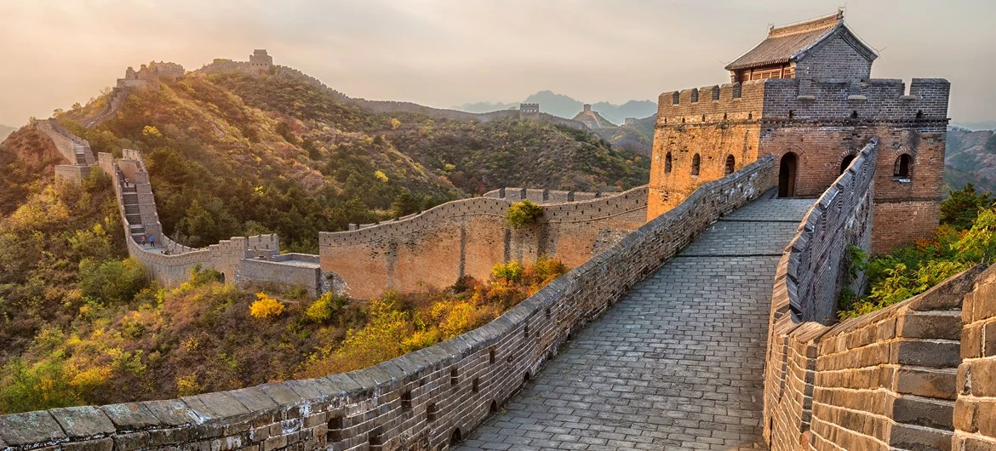
BACK IN THE DAY
The Great Wall of China built 1300 - 1600
The Great Wall of China, still going strong after 650 years

Slide 4
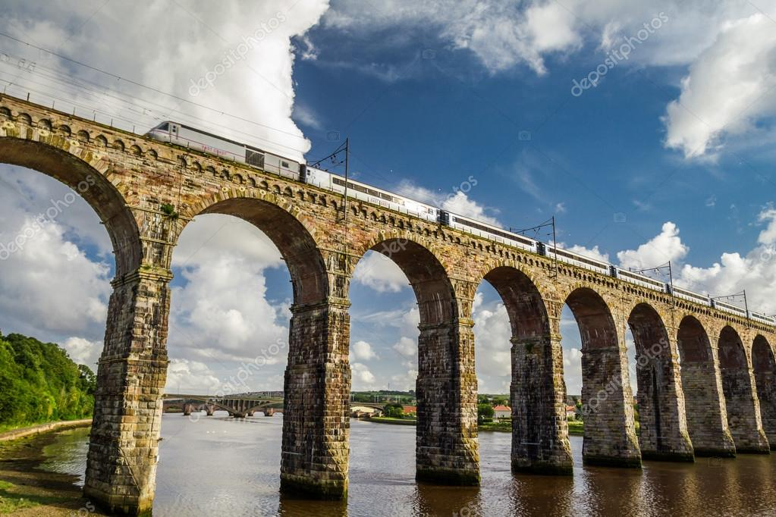
BACK IN THE DAY
Royal Border Bridge built 1850
A rail bridge that withstood the Flying Scotsman at 100mph complete with passengers and British Rail heavy duty cheese sandwiches.

Slide 5
LEAN AND MEAN
PROJECT DESIGN & EXECUTION
TECHNOLOGY
RESEARCH
EXPERIENCE
LEAN & MEAN
FIT FOR PURPOSE
BUDGET & SCHEDULE

Slide 6
LEAN AND MEAN
As time wore on, we had to become more and more aware of those issues, as well as new ones that came along with tighter legislation, laws, and recommended practices.
These could in most part be quantified and dealt with using clever mathematics, research, and experience. Clients demanded that projects be executed using the latest technology and practices, all within the tight constraints of budget and schedule.
Lean and mean, value for money, and return on investment were some of the many catch phrases that could be heard across the boardroom table, along with guarantees and assurances, and that all eventualities had been taken care of. At the end of the day, the budget, schedule, risks, and rewards could all be quantified and dealt with by the implementation of quality design and best project management practices.

Slide 7
LEAN AND MEAN
I hoped that within my old written articles, I had dealt with these issues in a manner that made their quantifying easier, and with my many years of experience under my belt, I could highlight some of the common pitfalls that could put any design or project at risk.
So that is the past, now let’s come to the present day and the matter at hand.
I have been asked to put pen to paper once again and elaborate on what I had done previously. This I thought should be easy enough, because after all only a handful of years had passed by. I decided to use one of my earlier articles “Challenges of Working in Africa“ as the template but move the boundaries to cover as much of the world as I could.
The first subject to be tackled was that of climate change and political unrest, something that is particularly important to consider in Africa, but not maybe of the utmost importance elsewhere. Europe and the Americas have been relatively stable on these fronts in time gone by, so this section should be a basic cut and paste job, I thought!

Slide 8
LEAN AND MEAN
Oh Boy! Thankfully I had put my writing pad down for the night and allowed my thoughts to ferment till the morning. Whilst fermentation may be beneficial to the making of a fine Merlot, it proved to be the opposite in this case. The quiet hours had done nothing but create a multitude of changes to my cut and paste plan.
The facts upon which we as engineers previously based our designs and project management procedures have been “pummelled“ by the activities in the new world. Most of this is attributed to two things. Global warming and global conflict.
Let’s delve into just a few issues that will show the magnitude of what we now must try and quantify.

Slide 9
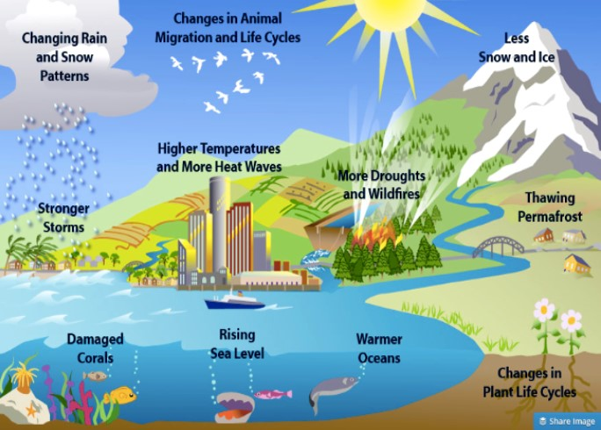
CLIMATIC CONDITIONS
GLOBAL WARMING

Slide 10
CLIMATIC CONDITIONS
Previously, climatic conditions such as maximum and minimum temperatures, wind speeds, rainfall, landslides, seismic effects and even the risk of fire could be considered in our designs, by simply investigating historical data and the possibility of it occurring again. How on earth do we do that now!
The old data such as the 1 in 100-year occurrence, is now not going to be sufficient. Unless you have just woken up from a 10-year coma, you will be very aware of the extreme weather conditions the world is now experiencing. I am not merely talking about the magnitude of these, but also the increased frequency and unusual locations at which they now occur.

Slide 11
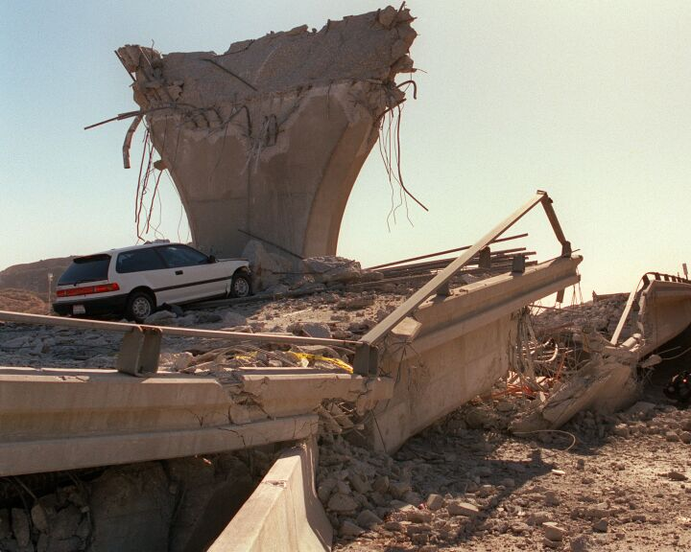
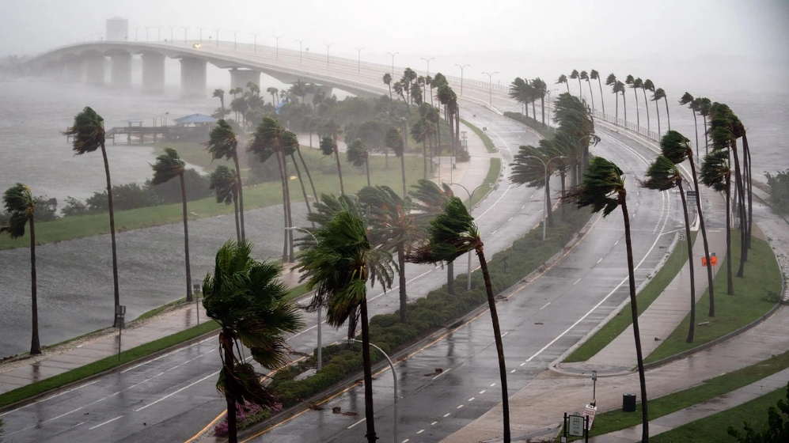
CLIMATIC CONDITIONS
TORNADO’S &
HURRICANES
EARTHQUAKES
Massive earthquakes and hurricanes doing damage to urban and rural places that have
never historically seen such events before.

Slide 12
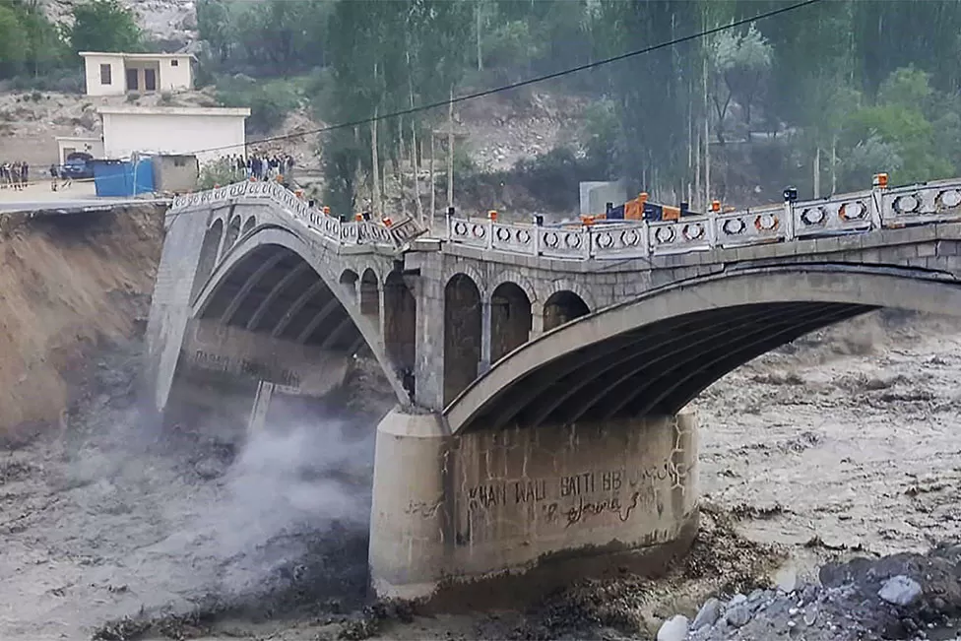
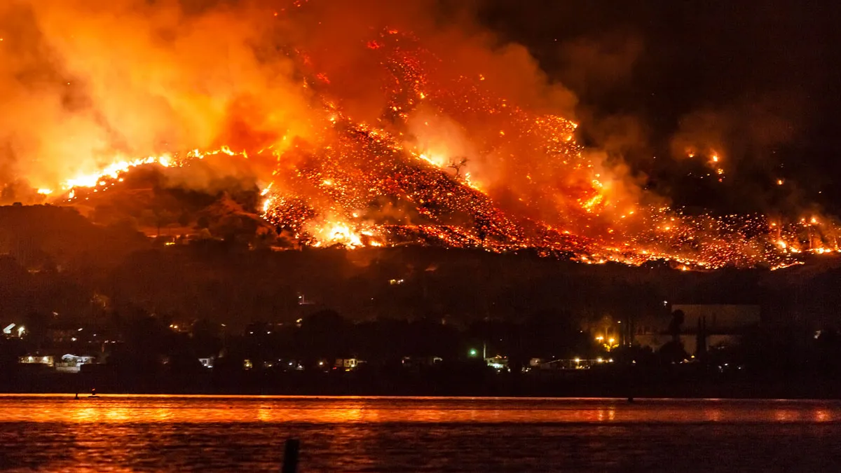
CLIMATIC CONDITIONS
FLOODS
FIRE
Extreme drought, fires and floods in Pakistan and Australia are prime examples

Slide 13
CLIMATIC CONDITIONS
I think we have all been shocked by the recent destruction and loss of life due to the earthquakes in Turkey and Syria. There is little doubt that this was exacerbated by the unforgivably poor construction of the residential high-rise buildings, despite the existence of new, very strict building legislation after the previous earthquakes that hit this region. Construction companies were allowed to ignore these if they paid monies to the government. This money is a drop in the ocean to the money that is now needed to repair and rebuild.
I recently took part in a seminar held by a well know investment bank. As per normal none of the “experts” could tell you where to invest, should you be in the fortunate position of having some spare cash under your mattress. What they did make very clear however, was that the companies who were faring better than others, had clear and precise mitigating and recovery procedures in place should any of the previously mentioned global events occur. To invest in these was seen as a good way to hedge against the massive losses that would see your hard-earned cash disappear literally in a puff of smoke.

Slide 14
CLIMATIC CONDITIONS
Global conflict and unrest are something that does not directly influence engineering design, but it certainly has a significant influence on project execution. Governments seem to collapse and rise at a frightening frequency. Military conflict, which can vary from a vigorous sable rattle to a full-scale war, can play havoc to any of the best made plans.

Slide 15
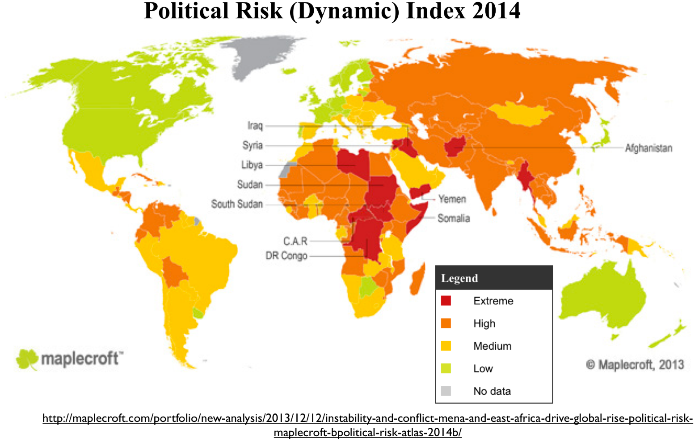
GLOBAL CONFLICT
10 YEARS AGO
This map shows the major world conflicts in 2014. These can be seen in red.

Slide 16
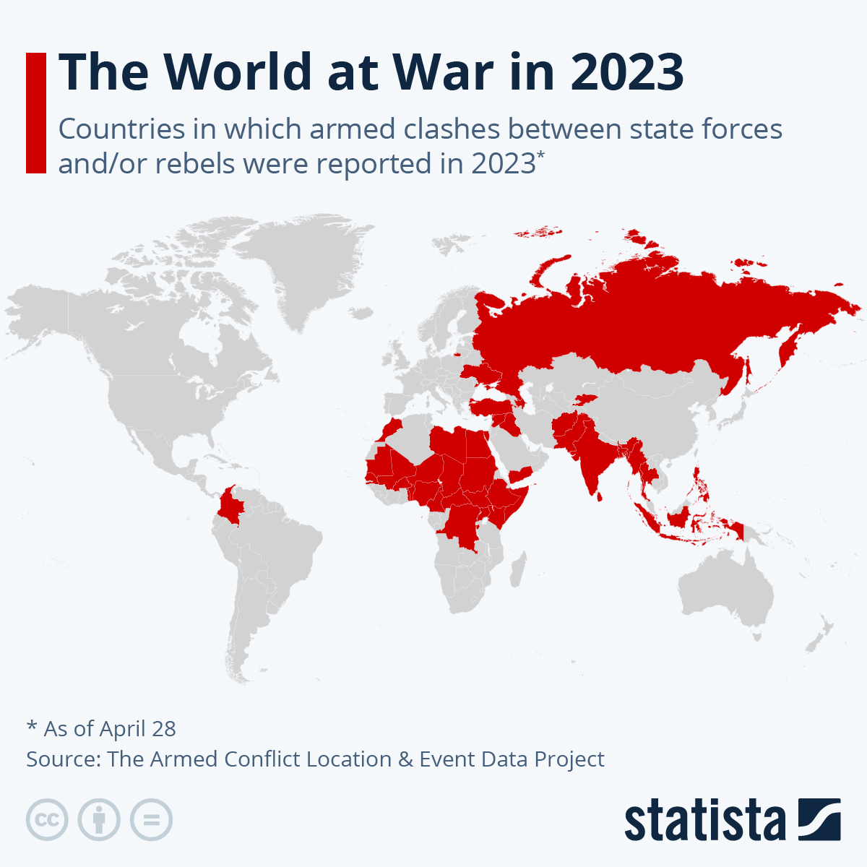
GLOBAL CONFLICT
PRESENT DAY
Now see a similar map of 2023 and the massive increase in areas of red.

Slide 17
HEALTH PANDEMICS
During the period 1900 to 2000 the world faced only two or three flu pandemics which killed less than 25 million people worldwide.
Since 2000 we have seen 4 major world pandemics.
HIV/AIDS approx 33 million deaths up to 2022.
SARS/MERS approx. 1 million deaths
Swine Flu approx. 2 million deaths
COVID approx. 32 million deaths and counting.

Slide 18
HEALTH PANDEMICS
Global health pandemics have also increased significantly over the years. Whilst the last
century had its own pandemics, the Spanish flu being the worst, the severity was relatively
small, and it was infrequent. The past 24 years of this century has already seen a frightening
increase in their frequency and the number of deaths.
How do we as new age engineers and project managers deal with this? A colleague of mine
once said that working these days is like trying to juggle jelly!!
As a design engineer it is easy to find yourself adopting some of the “ back-in-the-day “ solutions, building things big and strong enough to deal with any eventuality. As a project manager it is also easy to adopt the philosophy of having enough money in the budget to cope with them. As an alternative however, we could also design and construct things that can be easily repaired or replaced.

Slide 19
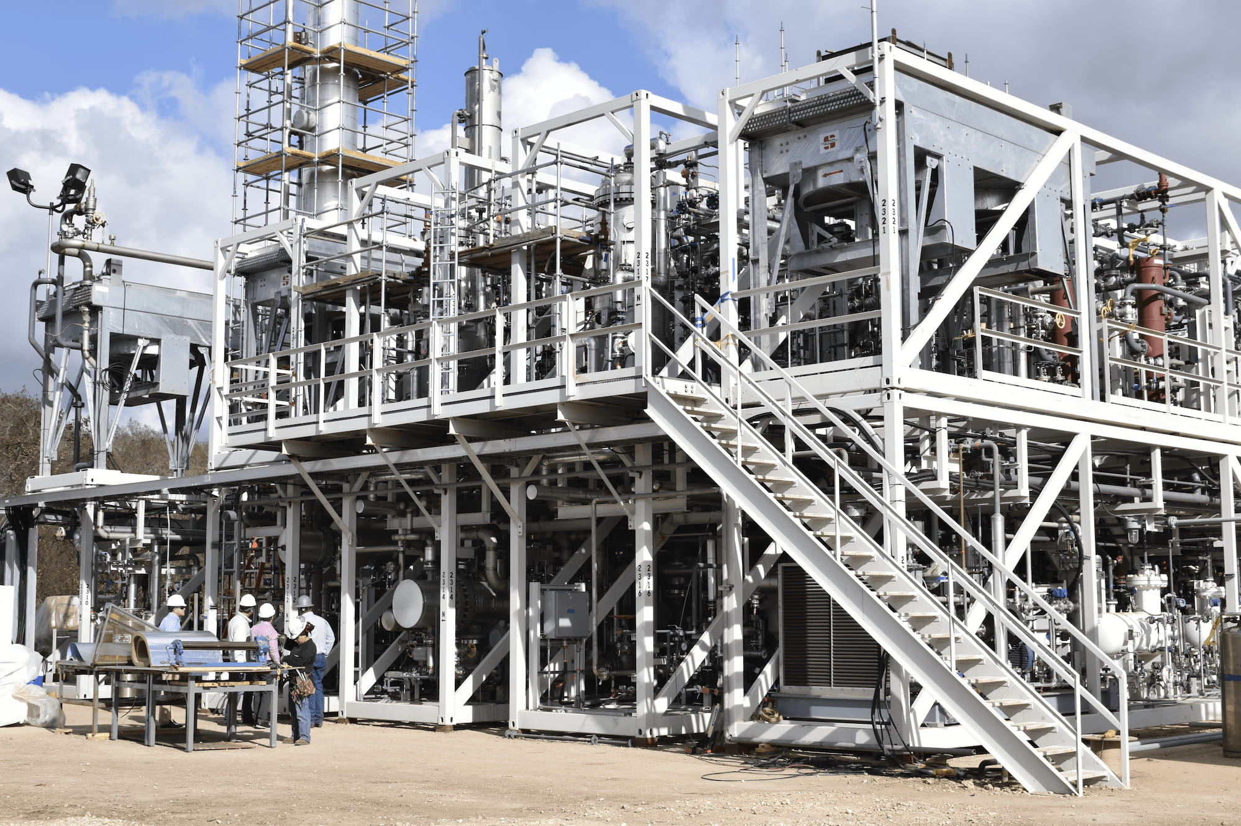
DESIGN SOLUTIONS
MODULAR DESIGN

Slide 20
DESIGN SOLUTIONS
Maybe a sort of “Lego based“ plant. No more multi-level structures that are susceptible to earthquakes or very high structures which carry vital commodities for production, which if damaged can be catastrophic to operations.
Can a low-level modular type of plant reduce the risk of these failures?
If a section of the plant gets damaged, you lift it out and drop a new one in, so to speak.
Are mega long overland conveyor systems too much of a risk now?

Slide 21
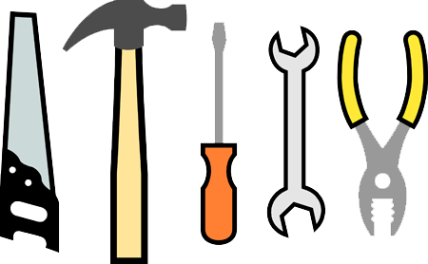
DESIGN SOLUTIONS
K.I.S.S
Keep It Sweet & Simple

Slide 22
DESIGN SOLUTIONS
Do we need more than ever to adopt the “KISS“ modus operandi.
Ok, this may be easier said than done, but that concept does have a place in our industry. It would possibly require more real estate to implement, and I can see that there would be additional costs linking all these sections together, but they need not be designed for the complete life of plant. One would have to conduct some sort of cost versus risk study, but if the risk of damage and loss to production is high, it may just be a worthwhile exercise.
There is no doubt that control and instrumentation systems must be upgraded from the norm, to detect catastrophic failures and instantaneously implement measures to prevent loss of life and extreme collateral damage.
Having been involved in several legal confrontations between clients and designers, where the latter have been accused of not considering and catering for the “ unknown “, it is imperative that we now consider these new, ever-increasing arrays of possibilities.

Slide 23
SUMMARY
In summary then we can undeniably state that issues such as global warming, global conflict and crippling health pandemics are going to have a severe impact on the way that we design and implement project.
To ignore these risks is surely foolhardy and will put your project on the slippery slope to failure!
FOOD FOR THOUGHT

